Slide 1
AGGLOMERATIVE ALGORITHM
CLUSTERING ALORITHMS

Slide 2
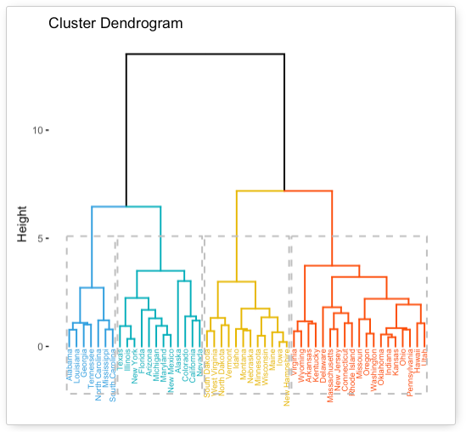
What is Agglomerative Clustering?
Definition: A hierarchical clustering method that builds a tree of clusters by progressively merging them.
Key Features:
Creates a dendrogram to represent cluster relationships.
Suitable for a variety of data types.
Key Concepts of Agglomerative Clustering
Hierarchical Structure: Starts with each data point as a separate cluster, merges them iteratively.
Distance Metrics:
Different ways to measure distance (e.g., Euclidean, Manhattan).
Linkage Criteria:
Determines how the distance between clusters is calculated (e.g., single, complete, average).

Slide 3
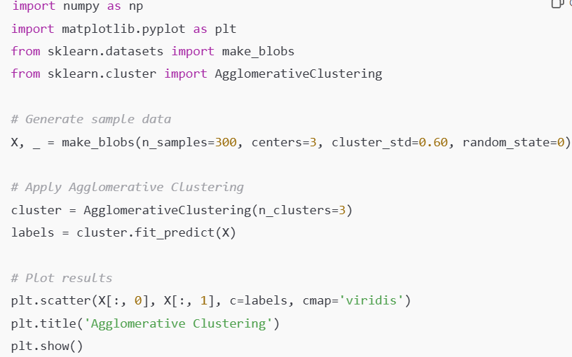
AGGLOMERATIVE in scikit-learn
Examples:

